Slide 1

Semarchy xDM
Integration Design Key Decisions
30 Jan 2023

Slide 2
Key Design Decisions
Minimise payload endpoints from Semarchy.
Parameterise functionality of endpoints.
All interfaces are batch driven from Semarchy.
GIP to do the mapping and filtering to target systems.

Slide 3
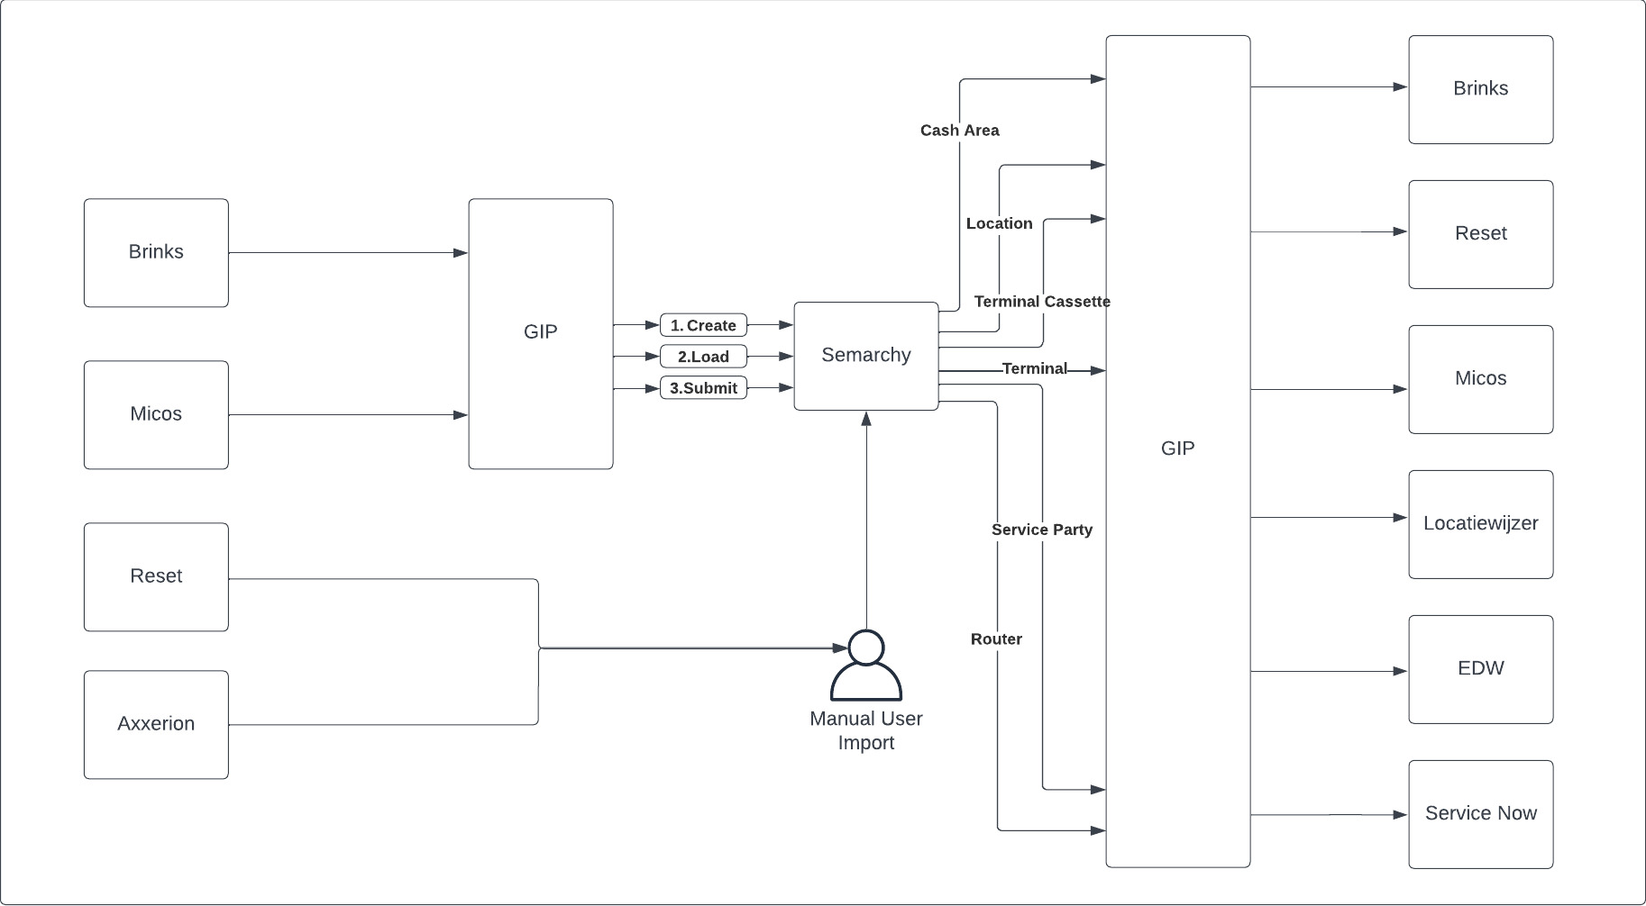
Integration Architecture

Slide 4
Minimise payload endpoints from Semarchy.
Description: | Pros and Cons
The API endpoints which are to be built into Semarchy. The main options here are: One endpoint per entity per system One endpoint per logical entity One endpoint per physical entity
Pros | Cons
Reduced rework for future model changes Reduced maintenance with less endpoints Single “source of truth” for data access | System specific mappings necessary in GIP per integration Slightly more complex delta filtering than physical records
Recommendation
Option 2. Create a set of “logical” endpoints which allow re-use where possible, but also give a focused starting point when changes take place Note: Option 3 is “for free” with the out of the box APIs so is not considered.

Slide 5
Parameterise functionality of endpoints.
Description: | Pros and Cons
Reducing the number of API endpoints means that functionality, especially system specific requirements, may be compromised. For this reason, additional parameters can be baked into the Semarchy APIs to add this functionality back in
Pros | Cons
Keeps a single endpoint payload whilst giving additional response functionality Additional parameters/functionality can be added via SemQL | Parameters should be developed and released and less reliance on the $f SemQL parameter
Recommendation
Add known and necessary parameters into each of the logical endpoint APIs. These are, at least: Start and End date/time Future days (how many days until this record is published)

Slide 6
All interfaces are batch driven from Semarchy.
Description: | Pros and Cons
Different operational mechanisms can be used for integration, namely batch or real time (near-real time).
Pros | Cons
Batch driven interfaces require no additional infrastructure. Real time would require either additional API or queueing mechanism in GIP Orchestration of interdependent records is simpler | Data is not completely up to date in downstream systems
Recommendation
All interfaces from Semarchy are batch driven. These batches can be small (15 minutes) to give short windows for data becoming stale.

Slide 7
GIP to do the mapping and filtering to target systems.
Description: | Pros and Cons
Whether the mapping between the Geldmaat master data model and the various systems is done within Semarchy, GIP or somewhere else
Pros | Cons
Semarchy should be the source of truth for Geldmaat Semarchy should be semi-agnostic of any specific system GIP should only be responsible for mappings between systems. It should not need to perform business logic (although it may need to orchestrate business logic) | Slower development time, as tactical solutions should be avoided
Recommendation
Separate business logic (Semarchy) and system mapping (GIP) for both inbound and outbound interfaces.

Slide 8
Micos
When
Frequency
System Owner
Method | GET/POST/PUT
Authentication Mechanism
URL
Parameters
Mapping
Example Request
Example Response

